Slide 1
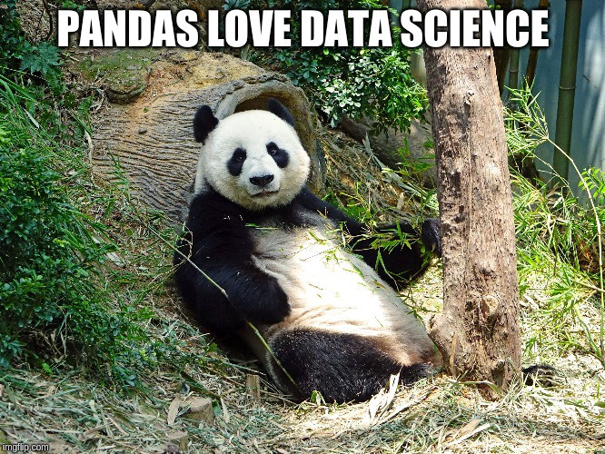
Source

Slide 2
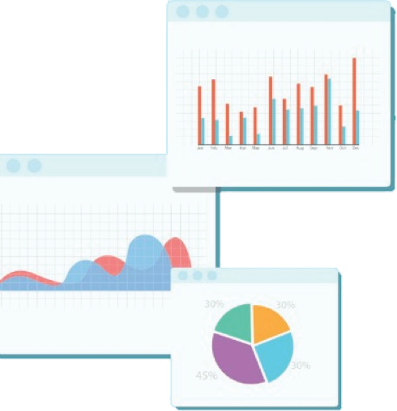

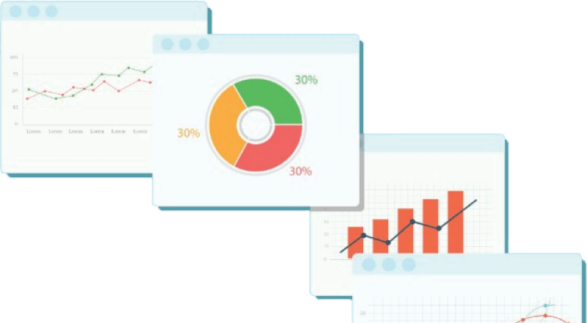
Welcome to Week 2
Lecture 1!
Data Science in Python &
Machine Learning

Slide 3
Learning Goals
By the end of this lesson you will be able to:
Recognize Week 2 Core Assignments
Make your assignment notebooks awesome - Assignment Tips
Explain the date and requirements for taking the Belt Exam
Set the index of a dataframe
Use .loc and .iloc to select specific data from a data frame
Filter rows to return a subset of data that matches a pattern
Use Pandas string methods to create filters based on string patterns.

Slide 4
Week 2 CORE Assignments
These MUST be submitted by Sunday December 12th:
Loading & Filtering Data
Titanic Data
Project 1 - Part 2
If a core assignment is missing, you will be placed on academic probation
even if you have done other assignments and
even if you have spent a lot of time learning and working
Note: If you accumulate 3 academic probations at any time during the program, you will be recommended for dismissal. Probations are cumulative and irreversible except in the case of documented mitigating circumstances.

Slide 5
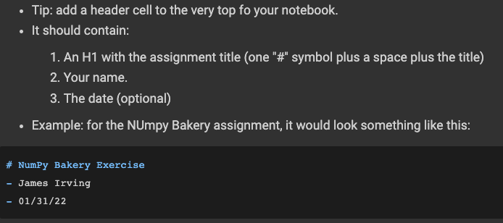
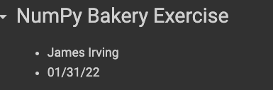
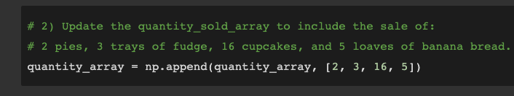

Assignment/Notebook Tips Colab Notebook
Assignment Header
Code Comments:
More tips/suggestions in the Colab Notebook!

Slide 6
BELT EXAM - STACK 1
End of Week 3 (Stack 1) Belt Exam:
Fri - Sun: 02/11 - 02/13
Must have submitted by 11:59 PM PST on Sunday 02/13
Eligibility:
80% Class Attendance
90% Successful Completion of Assignments
REQUIRED: complete all week 1 and week 2 assignments
Belt Exam Process
If you are eligible, you receive a belt exam unlock code.
Once unlocked, you have 24 hours to complete the exam.
RECOMMENDED: complete week 3 before starting exam.
NO help from TAs/other students/instructors
But you CAN use your notes and google.
1 chance to retake if you do not pass.

Slide 7
🥊 SLIDESHOWS vs NOTEBOOKS
Today’s Lecture:
📓 Notebook Version
📽 Slides Version (this slide deck)
We will walk through the notebook version during today’s lecture.
The same information is also in this slide deck.

Slide 8

Loading and Exploring Data
with Pandas 🐼!

Slide 9

Getting Data into Colab
Two Options:
Save file in Drive
Mount drive
Open file folder in Colab on the left:
Navigate to file in Drive
Right click file and ‘copy filepath’
Download data locally and upload to temporary Colab environment
Download data
Open file folder on the left
Drag and drop the file from your computer to upload it
Right click file and ‘copy filepath’

Slide 10
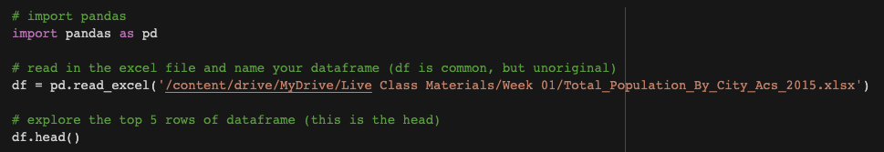
pd.read_csv() and pd.read_excel()
Different file types need different functions to load them:
.csv files → pd.read_csv(‘filepath’)
.xlsx files → pd.read_excel(‘filepath’)
‘filepath’ can be a remote URL as long as it points directly to a .csv or .xlsx file.
Other functions exist to load other file types, but these are the ones we will use.

Slide 11
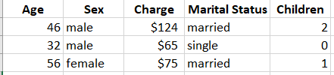

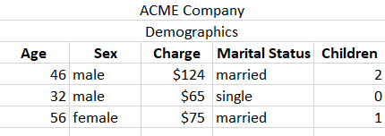
Headers
Header is top row. (This is default assumption)
pd.read_excel(‘path’)
pd.read_excel(‘path’, header = 0)
No header
pd.read_excel(‘path’, header = None)
Header present, but not at the top
pd.read_excel(‘path’, header = 2)

Slide 12
Quick Look at top and bottom of dataframe
This will give you the top 5 rows: df.head()
To see a different number of rows such as the first 8 rows: df.head(8)
To see the bottom 5 rows df.tail()
To see a different number of rows such as the last 11 rows df.tail(11)
To see random rows df.sample(5)

Slide 13
Checking data types
To get lots of info including data type, index, df.info()
and Column Names
To get JUST the data type for all columns: df.dtypes
To get the data type for just one column df[‘name’].dtypes

Slide 14
Slicing Dataframes:
Selecting specific column(s)
To select 1 column as a pandas series df[‘name’]
To select 1 column as a pandas dataframe df[[‘name’]]
To select multiple columns as a dataframe df[[‘name’, ‘Manufacturer’]]
Notice double square brackets for dataframe

Slide 15
How many rows and columns?
To get lots of info including data type, index, df.info()
and Column Names
To get the shape (rows, columns) df.shape
To get the number of rows len(df)
To get the number of columns len(df.columns)

Slide 16

Accessing and Changing Data

Slide 17
Index
When you read in a dataset, pandas will assign an index value to each row in the dataset
Remember Python uses 0 indexing, so the first row of data will be assigned 0.
You can leave this alone, but sometimes we may want to change our index to correspond with a column of our data
For example, if our data contains a column such as Employee_ID, that might be a logical column to use as the index
In order to be used as an index, every value in the column must be unique!

Slide 18
Setting the index
To set the index, you can use the following code:
df.set_index([‘Employee_ID’], drop = True, inplace = True)
Note that the drop = True means that the original column will be dropped and you will only have the data in the index column
The inplace = True means that you want to permanently change the df

Slide 19
Locators:
.loc and .iloc
Data in dataframes can be accessed directly using the powerful indexing tools, .iloc and .loc.
These are used like slicing, with square brackets, not like methods with parentheses.
Can be thought of as latitude and longitude
They both take arguments in the same format. df.loc[row, column] and df.iloc[row, column]
A row is one observation and a column is a variable or feature.
However, they differ slightly in how you reference the row and column.

Slide 20
Index Locator (.iloc)
If you know the index value or position, you can use the index locator (.iloc)
.iloc only takes integers
Return the entire 8th row as a series df.iloc[7] or df.iloc[7, :]
Return the entire 8th through 10th rows as a dataframe df.iloc[7:10] or df.iloc[7:10, :]
Starts at index 7 and ends at index 9 (the last number is exclusive)
Return the 2nd column of the of the 8th row df.iloc[7, 1]
As just the value in that cell
Return the 2nd through 5th columns of the 8th row df.iloc[7, 1:5]
As a series.
Note:
If you select 1 row, it returns the data as a series.
If you select more than one row, it returns the data as a data frame

Slide 21
General Locator (.loc)
Can take strings and integers
6th row of the column ‘name’ df.loc[5, ‘name’]
In Pandas, indices can be strings
Index ‘Jerry’ of column ‘height’ df.loc[‘Jerry’, ‘height’]
Indices ‘Jerry’ through ‘Hubert’ df.loc[‘Jerry’:‘Hubert’, ‘height’]
Of column ‘height’

Slide 22
General Locator Can Also be Used
to Change Values
Change Jerry’s height to 6.5 df.loc[‘Jerry’, ‘height’] = 6.5
Change ‘Jerry’ through ‘Hubert’s
Heights to the mean of all heights
df.loc[‘Jerry’:‘Hubert’, ‘height’] = df[‘height’].mean()

Slide 23
Filters
Filtering is the process of selecting data based on particular criteria
We often want to focus on a subset of our data.
You can use boolean expressions to filter rows by the value in a column.
You can select using >, <, == , or any other function or method that returns a boolean
To select all columns for whose age is 15: df.loc[df[age] == 15, :]
To select the names of people who are 15: df.loc[df[age] == 15, ‘name’]

Slide 24
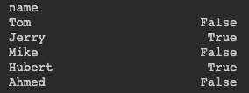
Filtering (cont.)
Using a series with a boolean expression returns a series of booleans:
df[‘age’] > 15 returns:
If we use this boolean series as an index value with .loc, it will only return the rows with ‘True’.
To return only the rows for people over the age of 15, we can use: filter = df[‘age’] > 15
df.loc[filter]
We could also change only their height! df.loc[filter, ‘height’] = 5.5

Slide 25
Boolean String Methods
There are a lot of string methods and many return booleans!!
The previous example showed how to filter for a string that starts with ‘B’
df[‘City’].str.startswith(‘B’)
There are similar methods for ends with or contains
df[‘City’].str.endswith(‘i’) outputs cities that end in ‘i’ such as Miami
df[‘City’].str.contains(‘or’) outputs cities that have ‘or’ in them such as New York

Slide 26
Combining locator and min or max
df.min() gives us the minimum value, but how do we find information about the data with this minimum value?
Option 1: Assign a variable and use locator
min_value = df[‘column’].min()
df.loc[df[‘column’] == min_value, :]
Option 2: Put it all into one line of code
df.loc[df[‘column’] == df[‘column’].min(), :]

Slide 27
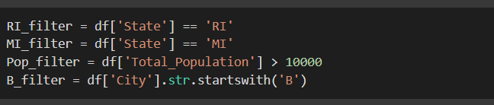
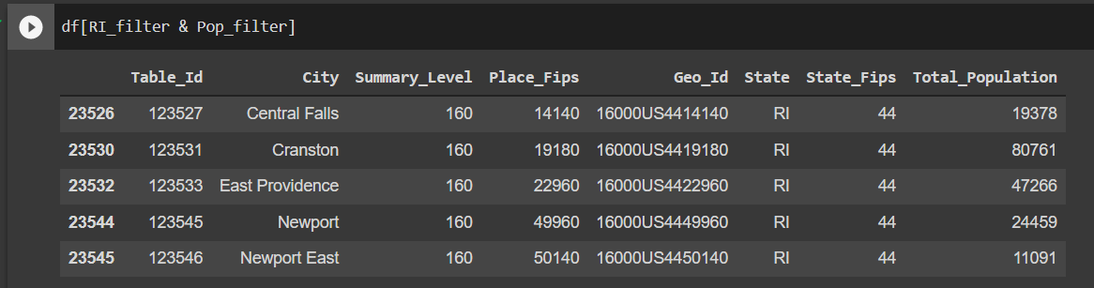
Multiple Filters
To combine filters use: [&, I, ~]
These translate to [and, or, not].
Now you can combine! For example all cities in RI that have a population greater than 10000
You can also filter without using .loc

Slide 28
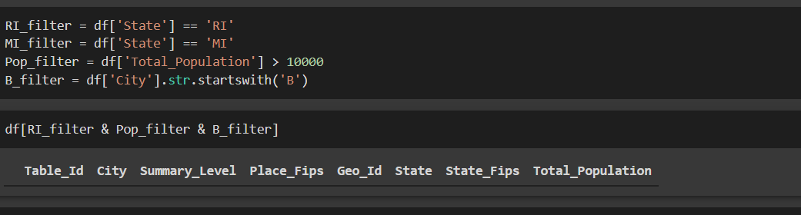
No output? No problem!
We tried combining three filters, and we did not get any output.
This is not an error!
This just means that there are NO data points that meet our criteria.
In this case, there are no cities in RI with a population greater than 10000 that also start with letter B

Slide 29
City Population Challenge - Revisited:
Make a copy of this Colab Notebook
Continue from header
“Exploring City Populations - Part 2 [NEW]”

